Slide 1


知识表示及其应用
SMP 2016
全国社会媒体处理大会
刘知远
清华大学自然语言处理实验室
liuzy@tsinghua.edu.cn

Slide 2
分布式表示方案
Distributed Representation
对象均被表示成稠密、实值、低维向量

Slide 3
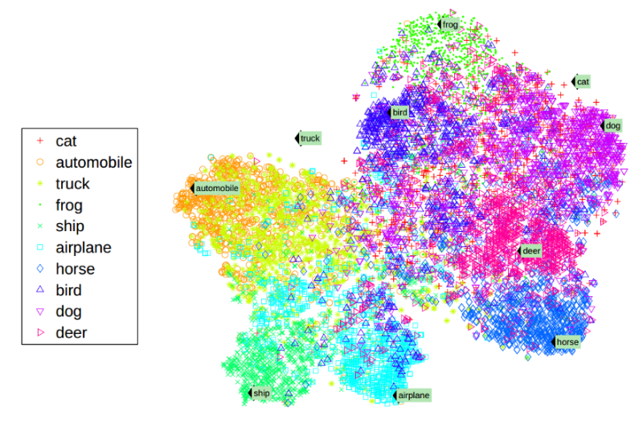
分布式表示的优势
解决社会计算中对象间的语义计算问题
知识
个性推荐
产品
知识计算
文本
社会网络分析
用户
统一语义空间

Slide 4
分布式表示的优势
表层数据
关联关系
深层语义
因果关系

Slide 5
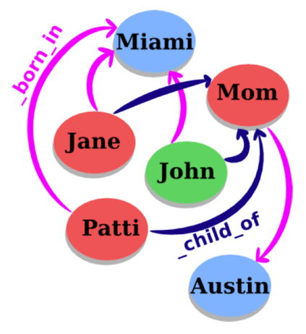
知识图谱实体与关系
知识图谱包括实体与关系
节点代表实体
连边代表关系
事实可以用三元组表示
(head, relation, tail)
代表知识图谱
WordNet: 语言知识
Freebase: 世界知识

Slide 6
人类文化史的定量研究
Science 2014
利用知识图谱中的名人信息
出生地点 → 死亡地点
Winckelmann Corpus
Freebase

Slide 7
社会知识图谱
利用知识图谱标注社会网络用户兴趣
Yang, Zhilin, Jie Tang, and William Cohen. Multi-Modal Bayesian Embeddings for Learning Social Knowledge Graphs. AAAI 2016.

Slide 8
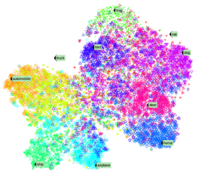
知识表示的挑战
知识图谱的典型表示方案
基于符号表示的三元组（RDF）
无法有效计算实体间的语义关系
解决方案：将知识映射到低维向量空间

Slide 9
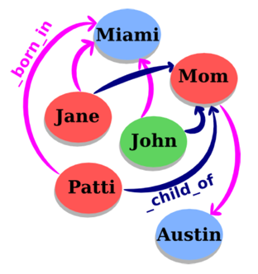
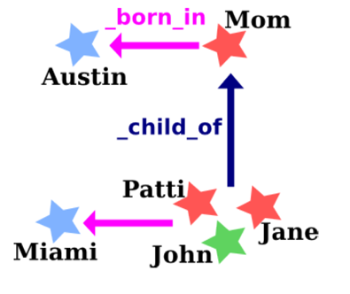
TransE: 将关系表示为翻译
对每个事实 (head, relation, tail)，将其中的relation作为从head到tail的翻译操作

Slide 10
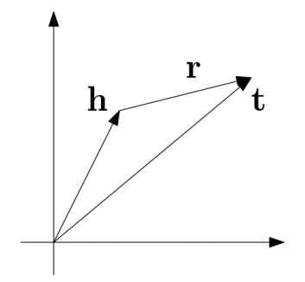
TransE: 将关系表示为翻译
对每个事实 (head, relation, tail)，将relation作为从head到tail的翻译操作
优化目标: h + r = t

Slide 11

评价任务：链接预测
WALL-E
_has_genre
?

Slide 12
评价任务：链接预测
WALL-E
_has_genre
Animation
Computer animation
Comedy film
Adventure film
Science Fiction
Fantasy
Stop motion
Satire
Drama
Connecting

Slide 13
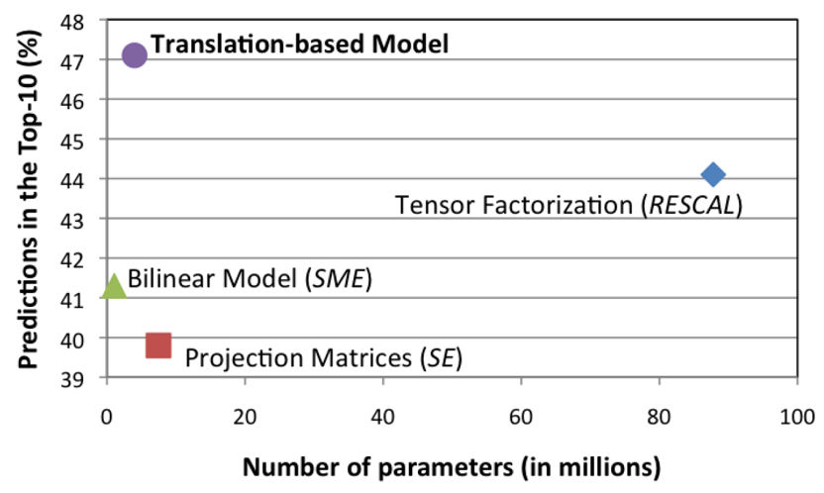
链接预测性能比较
Freebase15K

Slide 14
TransE样例
Entity | Tsinghua_University | A.C._Milan
1 | University_of_Victoria | Inter_Milan
2 | St._Stephen's_College,_Delhi | Celtic_F.C.
3 | University_of_Ottawa | FC_Barcelona
4 | University_of_British_Columbia | Genoa_C.F.C.
5 | Peking_University | Udinese_Calcio
6 | Utrecht_University | Real_Madrid_C.F.
7 | Dalhousie_University | FC_Bayern_Munich
8 | Brasenose_College,_Oxford | Bolton_Wanderers_F.C.
9 | Cardiff_University | Borussia_Dortmund
10 | Memorial_University_of_Newfoundland | Hertha_BSC_Berlin

Slide 15
TransE样例
Entity | China | Barack_Obama | Apple
1 | Japan | George_W._Bush | Onion
2 | Taiwan | Nancy_Pelosi | Strawberries
3 | South_Korea | John_Kerry | Avocado
4 | Argentina | Hillary_Rodham_Clinton | Pear
5 | North_Korea | Al_Gore | Cabbage
6 | Hungary | George_H._W._Bush | Broccoli
7 | Israel | John_McCain | Egg
8 | Australia | Colin_Powell | Cheese
9 | Iceland | Bill_Clinton | Bread
10 | Hong_Kong | Charles_B._Rangel | Tomato

Slide 16
TransE样例
Relation | /people/person/nationality | /location/location/contains
1 | /people/person/places_lived | /base/aareas/schema/administrative_area/administrative_children
2 | /people/person/place_of_birth | /location/country/administrative_divisions
3 | /people/person/spouse_s | /location/country/first_level_divisions
4 | /base/popstra/celebrity/vacations_in | /location/country/capital
5 | /government/politician/government_positions_held | /award/award_nominee/award_nominations
6 | /people/deceased_person/place_of_death | /location/administrative_division/capital
7 | /olympics/olympic_athlete/country | /location/us_county/county_seat
8 | /olympics/olympic_athlete/medals_won | /base/aareas/schema/administrative_area/capital
9 | /music/artist/origin | /location/us_county/hud_county_place
10 | /people/person/employment_history | /award/award_winner/awards_won

Slide 17
TransE样例
Head | China | Barack_Obama
Relation | /location/location/adjoin | /education/education/institution
1 | Japan | Harvard_College
2 | Taiwan | Massachusetts_Institute_of_Technology
3 | Israel | American_University
4 | South_Korea | University_of_Michigan
5 | Argentina | Columbia_University
6 | France | Princeton_University
7 | Philippines | Emory_University
8 | Hungary | Vanderbilt_University
9 | North_Korea | University_of_Notre_Dame
10 | Hong_Kong | Texas_A&M_University

Slide 18
TransE样例
Head | Stanford_University | Apple | Titanic
Relation | /education/educational_institution/students_graduates | /food/food/nutrients | /film/film/genre
1 | Steven_Spielberg | Lipid | War_film
2 | Ron_Howard | Protein | Period_piece
3 | Stan_Lee | Valine | Drama
4 | Barack_Obama | Tyrosine | History
5 | Milton_Friedman | Serine | Biography
6 | Walter_F._Parkes | Iron | Film_adaptation
7 | Michael_Cimino | Cystine | Adventure_Film
8 | Gale_Anne_Hurd | Pantothenic_acid | Action_Film
9 | Bryan_Singer | Vitamin_A | Political_drama
10 | Aaron_Sorkin | Sugar | Costume_drama

Slide 19
知识表示与关系抽取
融合文本与知识进行关系抽取
利用关系路径进行关系抽取
利用远程监督多实例进行关系抽取

Slide 20
融合文本与知识进行关系抽取
基于知识图谱的关系预测
基于文本信息的关系预测
r ~ t-h
Founder
Bill Gates
Microsoft
Bill Gates
was the co-founder and CEO of
Microsoft

Slide 21
利用CNN进行文本关系抽取
Daojian Zeng, Kang Liu, Siwei Lai, Guangyou Zhou, and Jun Zhao. Relation classification via convolutional deep neural network. In Proceedings of COLING.
Daojian Zeng,Kang Liu,Yubo Chen,and Jun Zhao. Distant supervision for relation extraction via piecewise convolutional neural networks. In Proceedings of EMNLP.

Slide 22
融合文本与知识进行关系抽取

Slide 23
关系抽取结果

Slide 24
融合实体描述的知识表示
利用实体描述信息提供关于实体的语义信息

Slide 25
融合实体描述的知识表示
Xie, et al. (2016). Representation Learning of Knowledge Graphs with Entity Descriptions. AAAI.

Slide 26
Zero-shot场景下的关系预测
对于新实体，根据描述信息有效得到实体表示

Slide 27
融合实体所在句子的知识表示

Slide 28
融合实体所在句子的知识表示

Slide 29
样例

Slide 30
知识表示与关系抽取
融合文本与知识进行关系抽取
利用关系路径进行关系抽取
利用远程监督多实例进行关系抽取

Slide 31
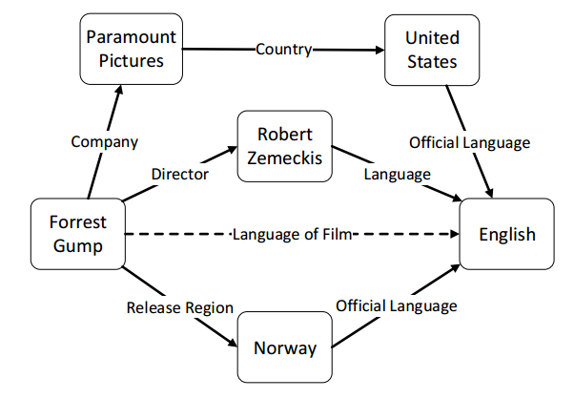
利用关系路径进行关系抽取

Slide 32
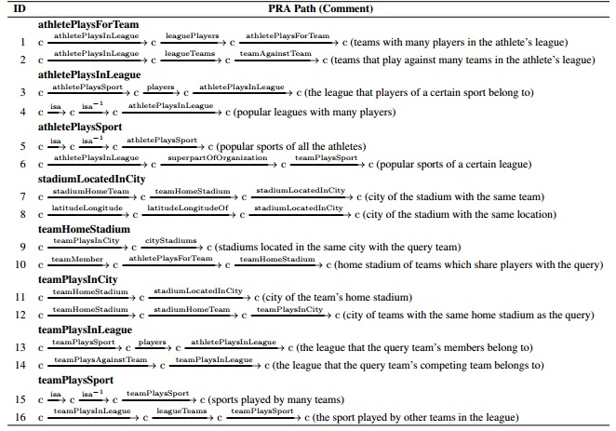
利用关系路径进行关系抽取
Path Ranking Algorithm
Lao, et al. (2011). Random walk inference and learning in a large scale knowledge base. EMNLP.

Slide 33
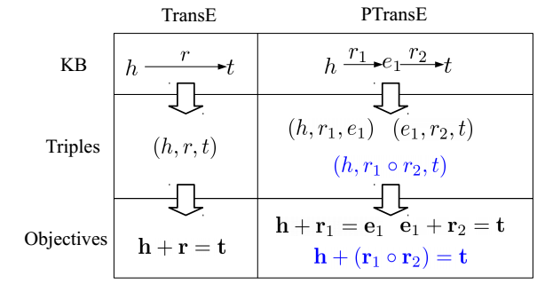
PTransE：考虑关系路径的TransE
Lin, et al. (2015). Modeling Relation Paths for Representation Learning of Knowledge Bases. EMNLP.

Slide 34
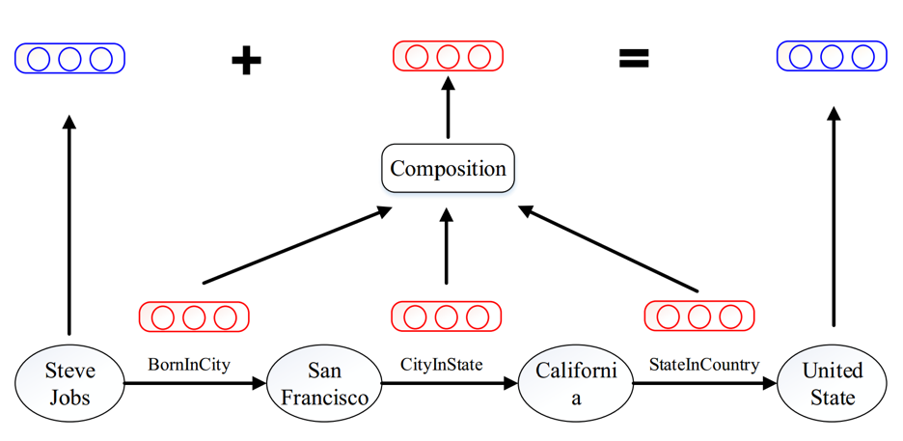
Path-based TransE

Slide 35
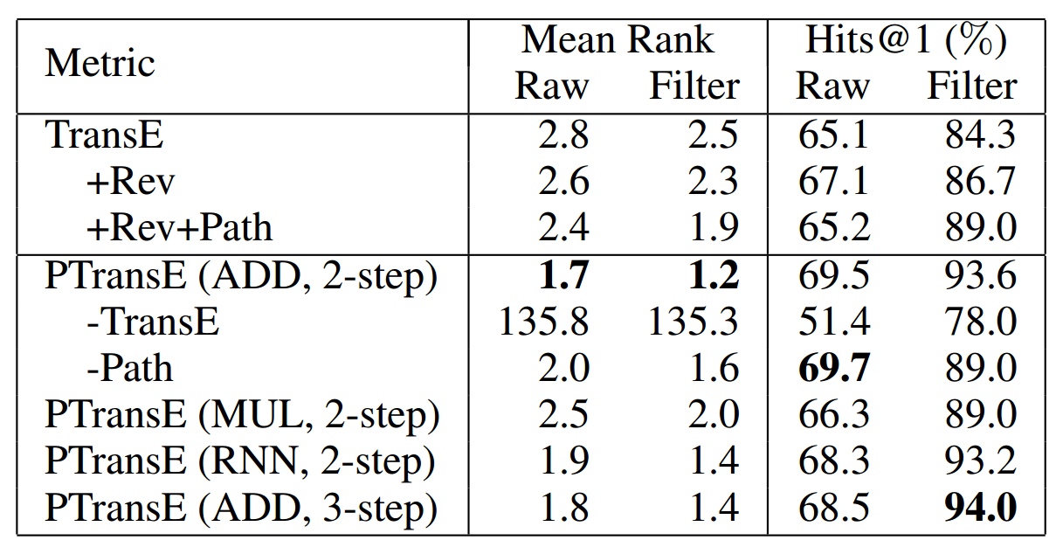
关系抽取结果
+10%

Slide 36
PTransE样例
Relation1 | /people/person/place_of_birth
Relation2 | /location/administrative_division/country
1 | /people/person/nationality
2 | /people/person/places_lived./people/place_lived/location
3 | /people/person/place_of_birth
4 | /music/artist/origin
5 | /olympics/olympic_athlete_affiliation/country
6 | /government/politician/government_positions_held
7 | /base/popstra/vacation_choice/location
8 | /people/deceased_person/place_of_death
9 | /government/political_appointer/appointees
10 | /location/administrative_division/country

Slide 37
PTransE样例
Relation1 | /location/location/contains
Relation2 | /location/location/contains
1 | /location/location/contains
2 | /location/country/second_level_divisions
3 | /location/country/administrative_divisions
4 | /location/administrative_division/capital
5 | /base/locations/continents/countries_within
6 | /base/aareas/schema/administrative_area/administrative_children
7 | /location/us_county/hud_county_place
8 | /location/country/capital
9 | /location/country/first_level_divisions
10 | /travel/travel_destination/tourist_attractions

Slide 38
知识表示与关系抽取
融合文本与知识进行关系抽取
利用关系路径进行关系抽取
利用远程监督多实例进行关系抽取

Slide 39
远程监督关系抽取的多实例问题
Founder
Bill Gates
Microsoft
Bill Gates
was the co-founder and CEO of
Microsoft
Bill Gates
announced to retire from
Microsoft
Bill Gates
and Paul Allen co-founded the IT giant
Microsoft

Slide 40
Sentence-Level Attention
Lin, et al. (2016). Neural Relation Extraction with Selective Attention over Instances. ACL.

Slide 41
关系抽取评测结果

Slide 42
关系抽取评测结果
Zeng, et al. (2015). Distant Supervision for Relation Extraction via Piecewise Convolutional Neural Networks. EMNLP.

Slide 43
关系抽取评测结果

Slide 44
Attention样例

Slide 45
开源代码
KB2E: TransE、TransH、TransR、PTransE
https://github.com/thunlp/KB2E
Fast-TransE
https://github.com/thunlp/Fast-TransE
比KB2E-TransE速度提升40倍！！
NRE: CNN、PCNN、x+ATT
https://github.com/thunlp/NRE

Slide 46
论文列表
Yankai Lin, Shiqi Shen, Zhiyuan Liu, Huanbo Luan, Maosong Sun. Neural Relation Extraction with Selective Attention over Instances. The 54th Annual Meeting of the Association for Computational Linguistics (ACL 2016).
Linlin Wang, Zhu Cao, Gerard de Melo, Zhiyuan Liu. Relation Classification via Multi-Level Attention CNNs. The 54th Annual Meeting of the Association for Computational Linguistics (ACL 2016).
Yankai Lin, Zhiyuan Liu, Maosong Sun. Knowledge Representation Learning with Entities, Attributes and Relations. International Joint Conference on Artificial Intelligence (IJCAI 2016).
Ruobing Xie, Zhiyuan Liu, Maosong Sun. Representation Learning of Knowledge Graphs with Hierarchical Types. International Joint Conference on Artificial Intelligence (IJCAI 2016).
Ruobing Xie, Zhiyuan Liu, Jia Jia, Huanbo Luan, Maosong Sun. Representation Learning of Knowledge Graphs with Entity Descriptions. The 30th AAAI Conference on Artificial Intelligence (AAAI 2016).
Yankai Lin, Zhiyuan Liu, Huanbo Luan, Maosong Sun, Siwei Rao, Song Liu. Modeling Relation Paths for Representation Learning of Knowledge Bases. The Conference on Empirical Methods in Natural Language Processing (EMNLP 2015).
Yankai Lin, Zhiyuan Liu, Maosong Sun, Yang Liu, Xuan Zhu. Learning Entity and Relation Embeddings for Knowledge Graph Completion.The 29th AAAI Conference on Artificial Intelligence (AAAI 2015).

Slide 47
知识表示与社会计算融合展望
构建带关系标签的社会网络，更精确地构建用户关系
构建面向专业领域的知识图谱，实现对社会网络中用户的知识计算与标注
构建面向人文领域的知识图谱，用于计算社会学的相关研究
从知识图谱中抽取推理规则，为寻找因果关系提供证据

Slide 48

感谢各位老师同学
http://nlp.csai.tsinghua.edu.cn/~lzy/

